Slide 1
Life Expectancy Prediction
Countries where COVID cases crosses mark of 1 million
Prediction of Life expectancy at birth

Slide 2
Problem statement
COVID 19 Affects each and every aspects of Human life like:
Health
Wealth
Mental health
Work life
To predict the Life expectancy at birth of the countries which, crosses more than 1 million cases.

Slide 3
Data Source
Global Health Observatory Under WHO
United Nation Organisation (UNO)
World Health Organisation
PLOS DIGITAL HEALTH
BMC (Springer Nature)
Data.WorldBank
World Data Bank
Macrotrends.net
Wikipedia

Slide 4
Dataset
The Global Health Observatory (GHO) data repository under World Health Organization (WHO) keeps track of the health status as well as many other related factors for all countries.
22 columns 2938 rows data of 193 countries out of which ,we selected 30 countries
All predicting variables was then divided into several broad categories:
Immunization related factors,
Mortality factors,
Economical factors
Social factors

Slide 5
Data Treatment
Columns Interpretation With Y variable
Exploration of data
Correction of Decimals Places
Try to correct misplaced Integers data by taking reference of WHO datasets
Correct Range of Columns
Scaling of data
Removal of multicollinearity
Nulls Imputation
Merging the column with same datapoints

Slide 6
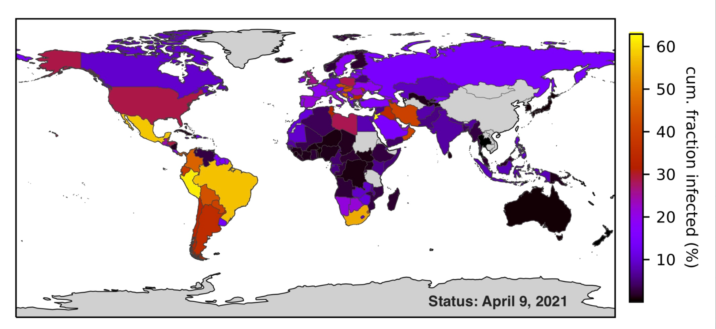
Infection Rate Worldwide

Slide 7
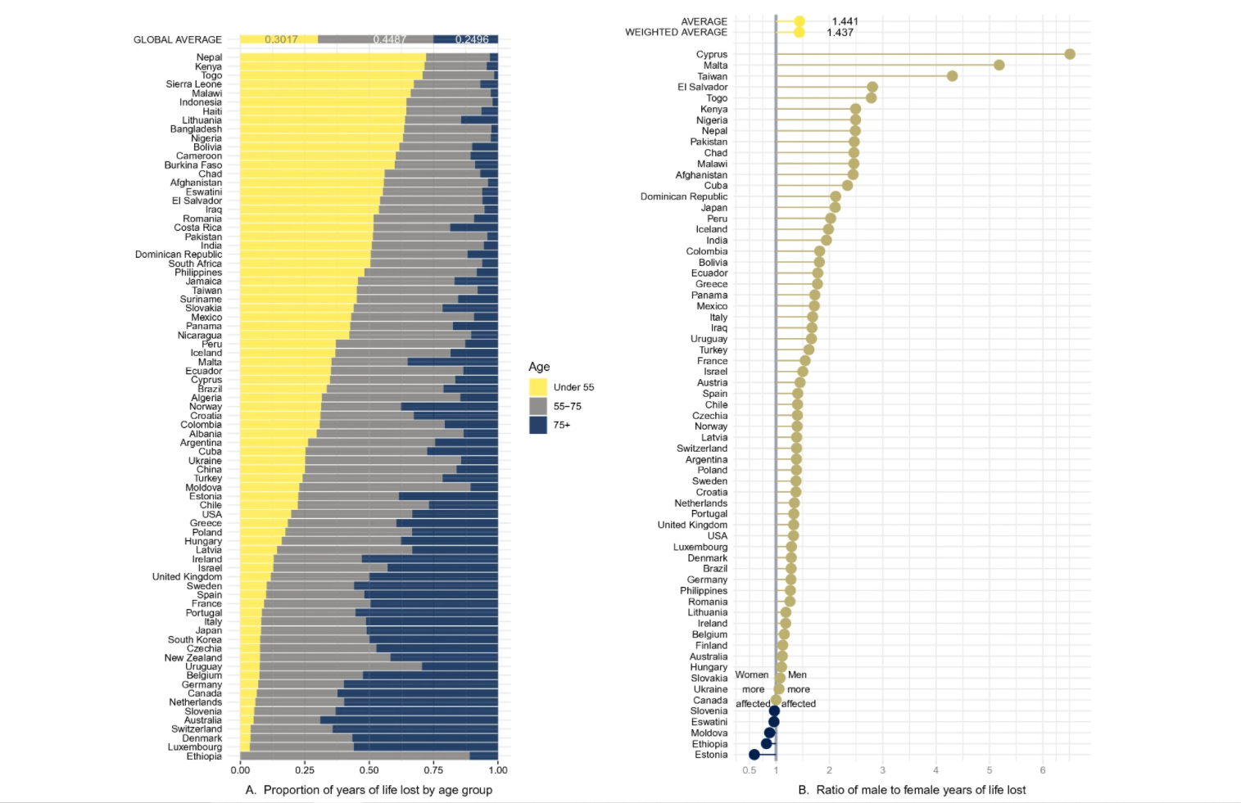
Model and summary

Slide 8
Model Used for Predictions
1.Linear Regression
2.Decision Tree
3.Hyper Tuned Decision Tree
4.Random Forest
5.Hypertuned Random Forest
6.K nearest Neighbors
7.SVM_Linear
7.1SVM_RBF
7.2SVM_poly
7.3VM_sigmoid
8.Gradient Descent Regressor
9.Ridge
10.AdaBoost Regressor
11.Lasso

Slide 9
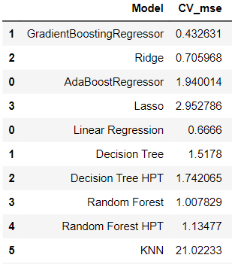
Cross-Validation results
Goal of Cross validation to find out Train and test Error to be some ,to overcome the Overfitting
So here we got Gradient Boosting Regressor has Lowest mse

Slide 10
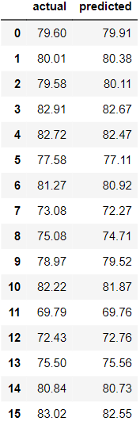
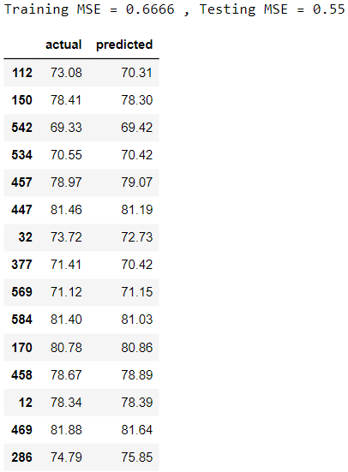
Actual test Results
Actual vs Predicted Linear Regression
Actual vs Predicted Gradient Descent
Test Results are for
1.Basic Model
2. Best Model

Slide 11
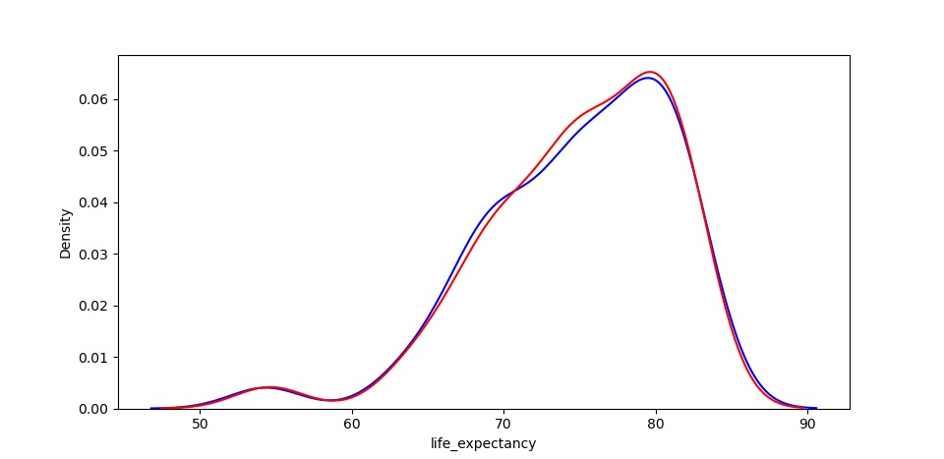
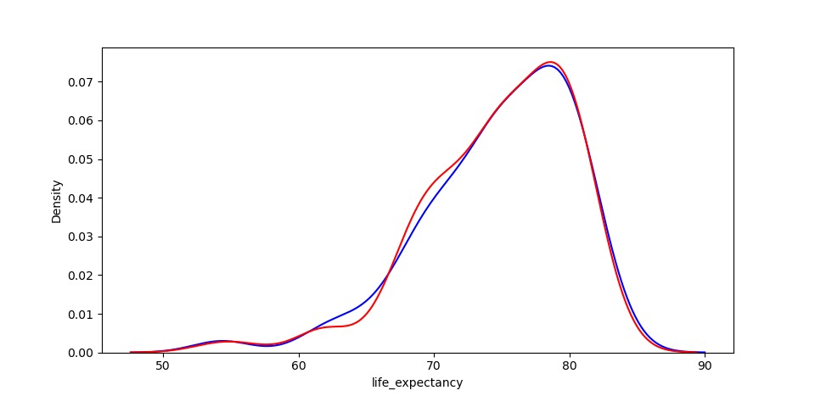
Comparison Chart
Plot of Gradient Descent (Act vs Pre)
Plot of Linear Regressor
(Act vs Pre)

Slide 12
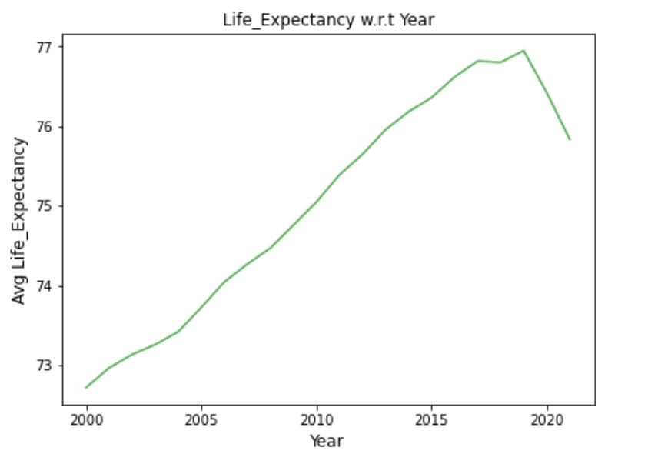
Conclusion
So, By prediction we got this Result ,
1.Life expectancy is Decreased in Year 2020 & 2021
2.Lot of countries are Facing This Because OF COVID situation
3.TO improve the Life Expectancy of Countries They must Improve their Facilities like
HDI,
BMI
Schooling,
Health Expenditure Percentage,
Vaccination
4.Decrese the
Alcohol Consumption rate,
Adult Mortality and
Infant Mortality

